Slide 1


UNIVERSITY INSTITUTE OF ENGINEERING
Academic Unit V
Bachelor of Engineering (Computer Science & Engineering)
Biology For Engineers
23SZT-148
Biology for Engineers
DISCOVER . LEARN . EMPOWER

Slide 2
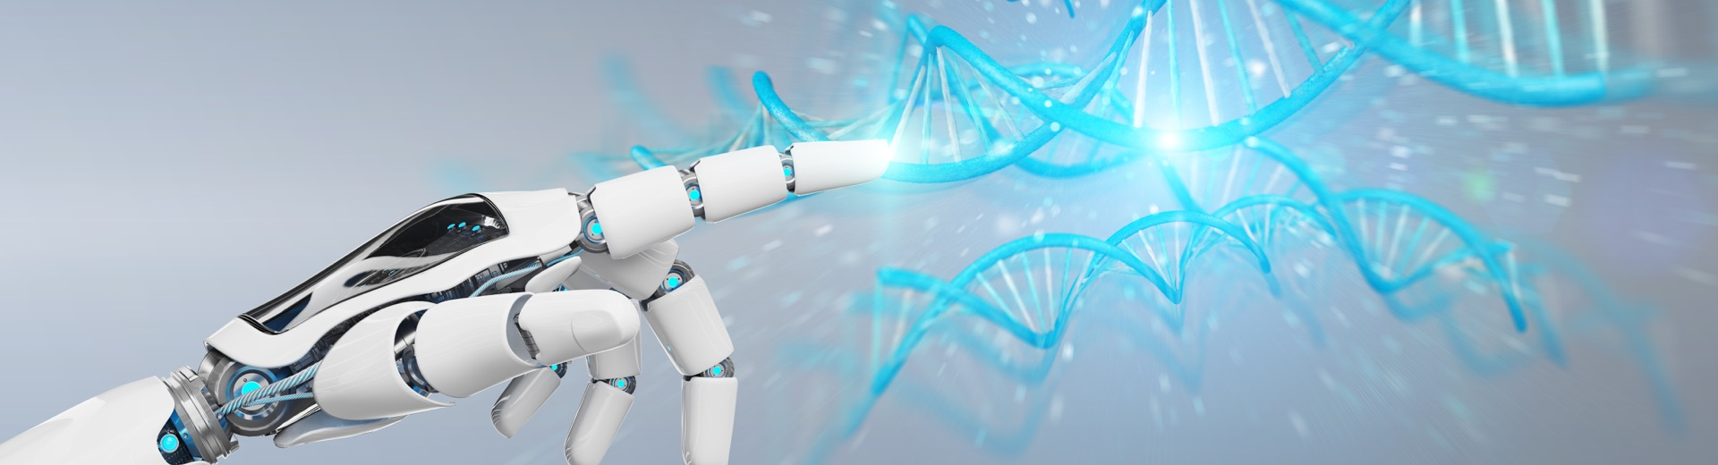
INTRODUCTION
Course Objective
This subject is designed to impart fundamental knowledge on basic of genetics and emerging fields of biology like biomedical recording system and medical instrumentation.
It is designed to impart knowledge that how to apply basics of biology in engineering.
https://www.uic.es/sites/default/files/uic-grau-bioenginyeria-hero-header_1.jpg
Biology for Engineers

Slide 3
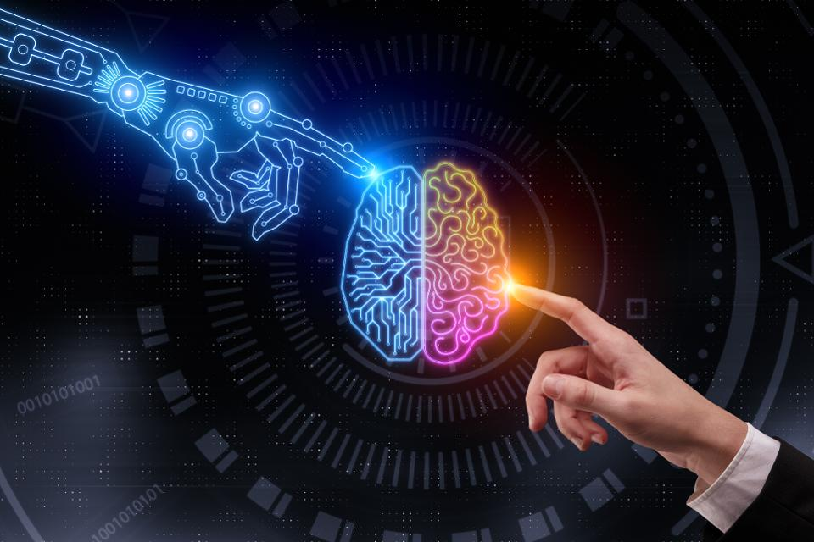
INTRODUCTION
Course Outcome
CO Number | Title | Level
CO1 | Identify the biological concepts from an engineering perspective. | knowledge
CO2 | Development of artificial systems mimicking human action. | Understand
CO3 | Explain the basic of genetics that helps to identify and formulate problems | Analyze
CO4 | Apply knowledge of measurement system, biomedical recording system and biosensors to excel in areas such as entrepreneurship, medicine, government, and education. | Apply
CO5 | Integrate biological principles for developing next generation technologies, | Create
Will be covered in this lecture
Biology for Engineers

Slide 4
SYLLABUS
Unit-1 | Importance of Biology In Engineering | Contact Hours: 15
Chapter 1 Significance of Biology in Engineering Chapter 2 Genetics | Introduction: Fundamental Differences between Science and engineering by drawing a comparison between eye and camera, Bird flying and aircraft. Significance of Biology in Engineering, Discuss how biological observations of 18th Century that lead to major discoveries, Examples from Brownian motion and the origin of thermodynamics by referring to the original observation of Robert and Julius Mayor. Genetics: Mendel’s laws, Concept of segregation and independent assortment, concept of allele, gene mapping, Gene interaction, Epitasis, Meiosis and Mitosis as a part of genetics. Mechanism of how genetic material passes from parent to offspring. Concepts of recessiveness and dominance. Concept of mapping of phenotype to Genes, single gene disorders in humans, concept of complementation using human genetics.
Biology for Engineers

Slide 5
Law of Gravitational Force
It was Sir Issac Newton, a mathematician, who deduced the Law of Gravitational Force.
It is well-known that he was once sitting under an apple tree when an apple fell down from the tree, compelling him to wonder how it came down to earth and did not go upward.
This resulted in Newton formulating that it is the gravitational force of earth that attracts all objects to itself.
It was formulated in Newton’s work Philosophiæ Naturalis Principia Mathematica or The Principia, first published in July 1687.
Biology for Engineers

Slide 6
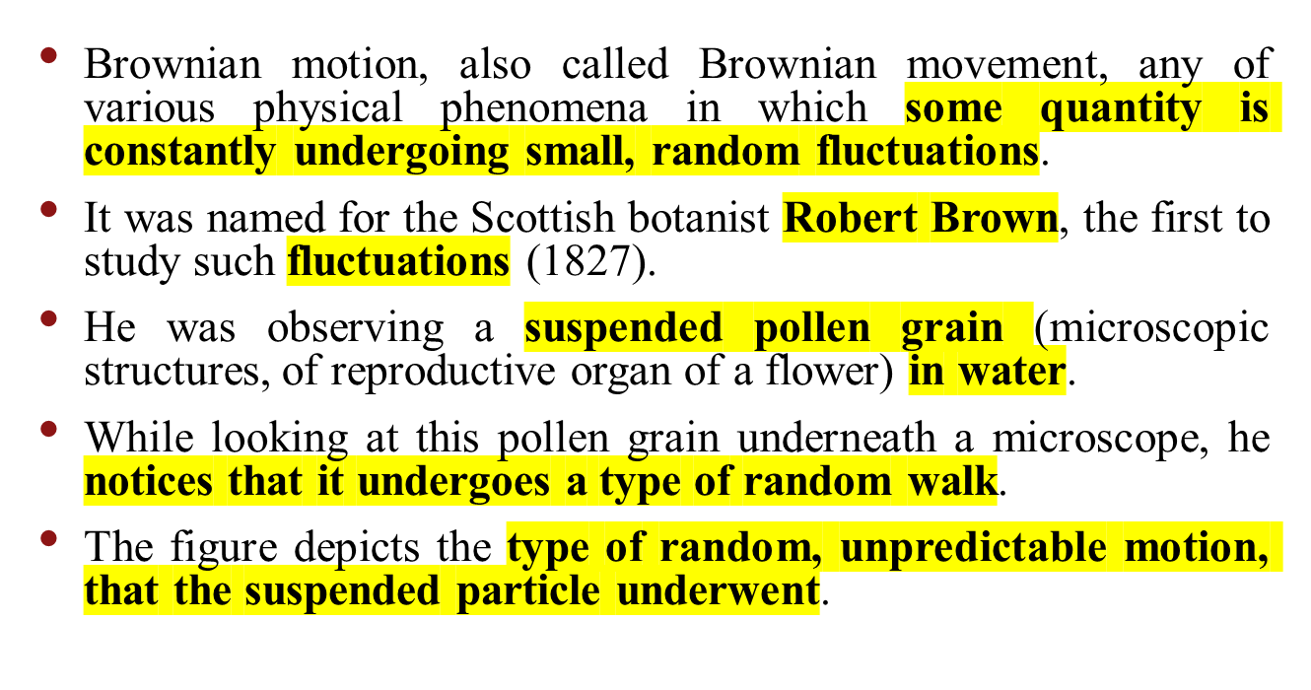
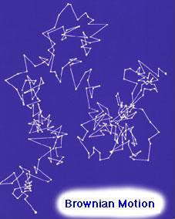

Brownian Motion and The Origin of Thermodynamics

Slide 7
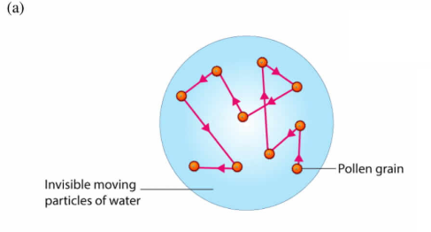
Biology for Engineers

Slide 8
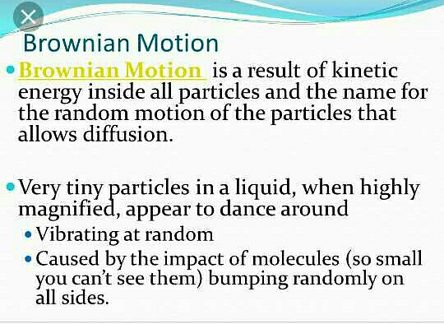
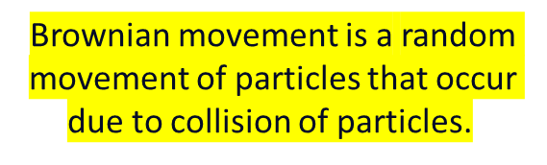
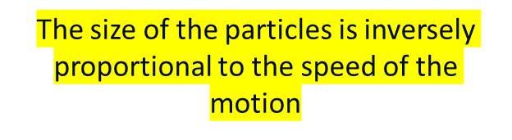

Slide 9
This random motion is now referred to as BROWNIAN MOTION, but the motion itself may be easily remembered as the "Drunken Sailor Walk".
At first Brown attributed this motion to signs of life.
However, when he repeated the experiment with an inorganic body he observed the same motion.
Now the phenomenon of Brownian motion has been discovered, but...
HOW DO WE EXPLAIN THIS SEEMINGLY RANDOM MOTION?
This question leads to two school of thought and a debate that lasted for 68 years!
Biology for Engineers

Slide 10
The phenomenon of Brownian motion caused much debate on the possible causes for this motion.
These debates lead to two opposed and contradicting sides.
There were the ENERGETICS, lead by William Ostwald, and the ATOMISTS, lead by Ludwig Boltzmann.
Biology for Engineers

Slide 11
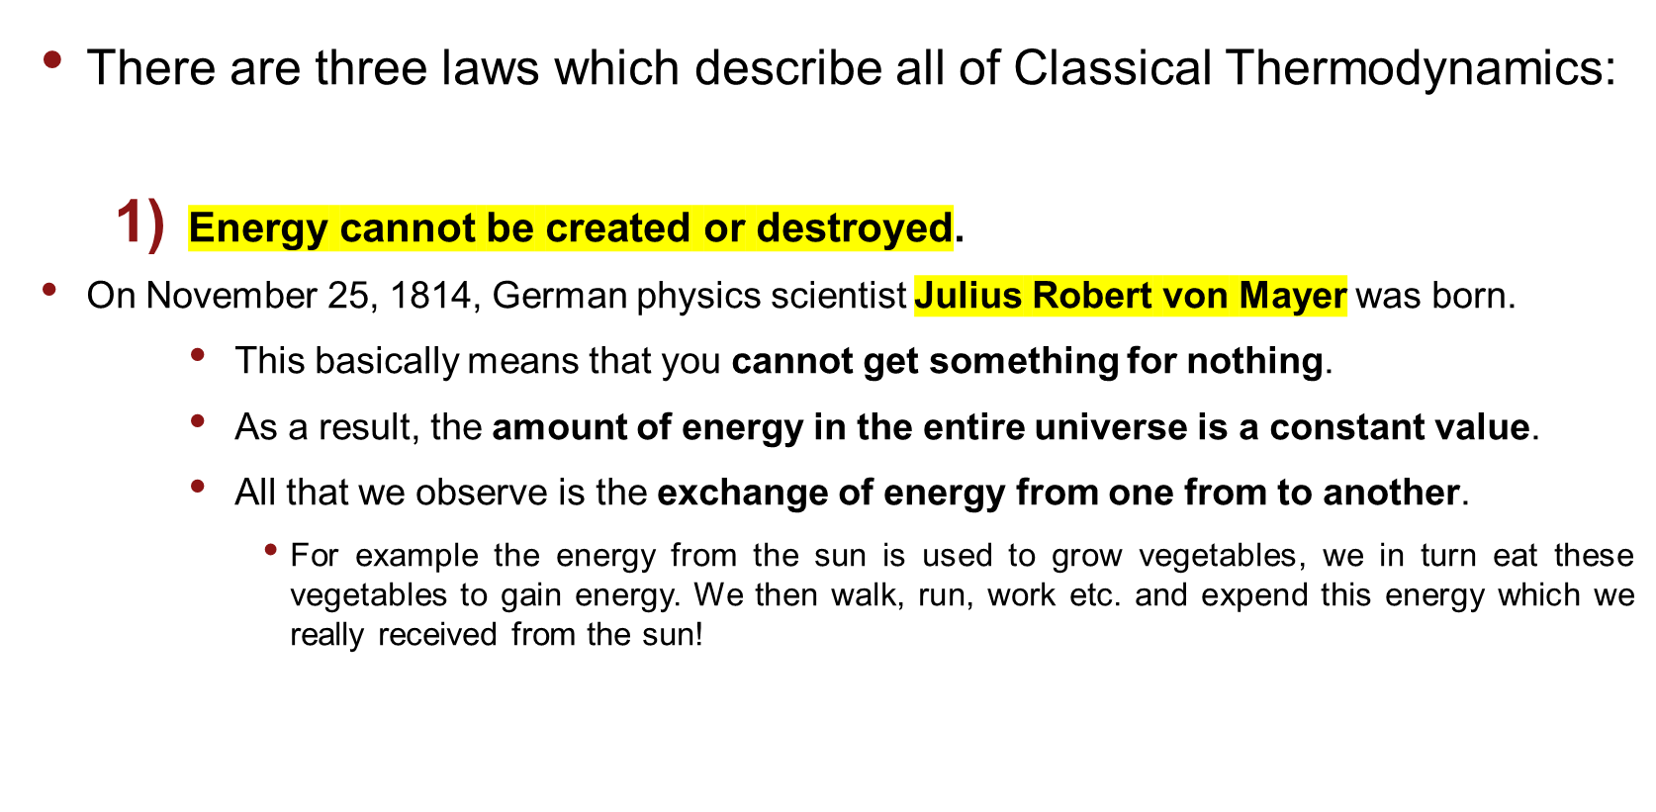
Classical Thermodynamics
Study of the relation between heat, work, temp and energy

Slide 12
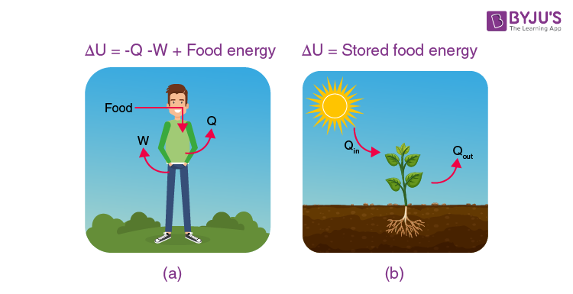
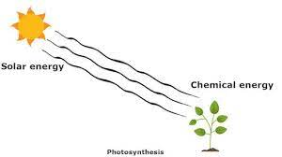
Biology for Engineers

Slide 13
Classical Thermodynamics
The entropy of a system always increases
  Entropy is basically the randomness or order of a system.
  The entropy always increasing, means that the randomness of the system increases or the order of the system decreases.
  The system is becoming more chaotic.
    For example, a liquid has more entropy than a solid and less entropy than a gas. This is because a solid has a very definite structure and is well ordered. Whereas a liquid has less order and a gas has even less! See the figure below, which depicts the structure of a solid, liquid and gas respectively.
Biology for Engineers

Slide 14
Classical Thermodynamics
You can never reach absolute zero.
  This is just a way of saying that you can never decrease the temperature to a point where the system has no energy, meaning it does not move.
  The temperature where this would happened is known as absolute zero, and is -273.15 degrees Celcius! Otherwise known as 0K or zero degress Kelvin.
Biology for Engineers

Slide 15
References
Biology - Important discoveries in biological science - Study, Evolution, Century, and Organisms - JRank Articles https://science.jrank.org/pages/885/Biology.html#ixzz75TcQUL6c
https://study.com/academy/lesson/key-events-in-the-history-of-biological-study.html
https://www.goldbio.com/articles/article/15-Great-biological-discoveries-that-revolutionized-life-science
http://scihi.org/julius-von-mayer-energy/#:~:text=Julius%20Robert%20von%20Mayer%20(November,of%20the%20founders%20of%20thermodynamics.&text=In%201842%2C%20Mayer%20described%20the,energy%20for%20any%20living%20creature.
Biology for Engineers

Slide 16


Biology for Engineers

